Slide 1
Java arrays: what is the index concept in an array? How to create and initialize an array? Types of arrays with examples?
-Sayali yadav

Slide 2
Java Arrays: what is the index concept in an array?
In Java, an array is a data structure used to store a collection of elements of the same type. Each element in the array can be accessed by an index, which represents its position in the array.
An array in Java has a zero-based index, meaning the first element is at index 0, the second at 1, and so on.
The index allows you to directly access each element in the array.
For example, in an array int arr [5]={10,20,30,40,50} , arr[0] will return 10 and arr[1] will return 20.

Slide 3
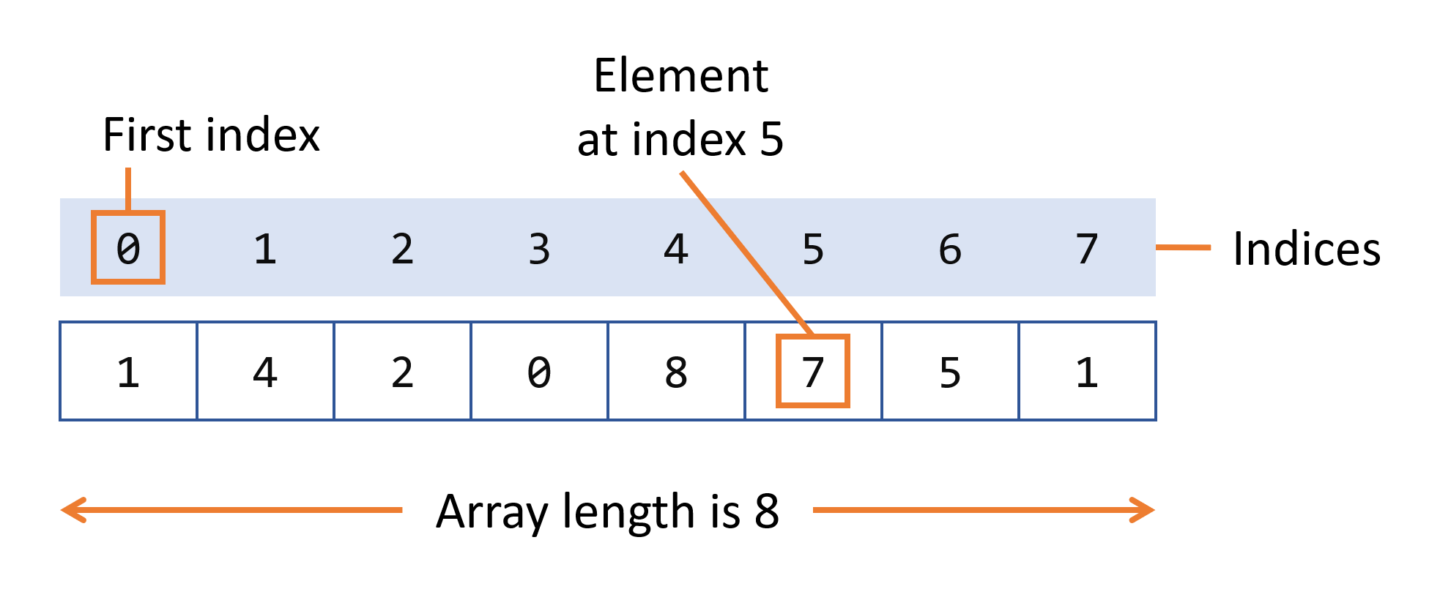
How to create and initialize an array?
In Java, you can create and initialize arrays in two main ways:
1) Declaration and then Initialization:
int[] numbers = new int[8]; // declares an array with 8 integer elements
numbers[0] = 1;
numbers[1] = 4;
numbers[2] = 2;
numbers[3] = 0;
numbers[4] = 8;

Slide 4
How to create and initialize an array?
2) Declaration with Initialization:
int[] numbers = {10, 20, 30, 40, 50}; // declares and initializes an array
3) Dynamic Initialization:
int size = 3;
int[] numbers = new int[size]; // array size can be set at runtime

Slide 5
Types of arrays with examples?
1) Single-Dimensional Arrays:
This is a simple list of elements arranged in a linear fashion.
2) Multi-Dimensional Arrays:
Arrays that have two or more dimensions, often used to represent matrices or tables.
1) 2D Array
2) 3D Array
int[] singleArray = {1, 2, 3, 4};
System.out.println(singleArray[0]); // Outputs 1

Slide 6
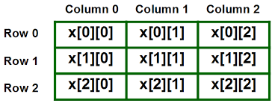
Types of arrays with examples?
2D Array
Syntax : datatype[][] arrayname = new datatype [rows][column];
int[][] matrix =
{
{1, 2, 3},-
{4, 5, 6},
{7, 8, 9}
};
System.out.println(matrix[0][1]); // Outputs 2 (1st row, 2nd column)

Slide 7
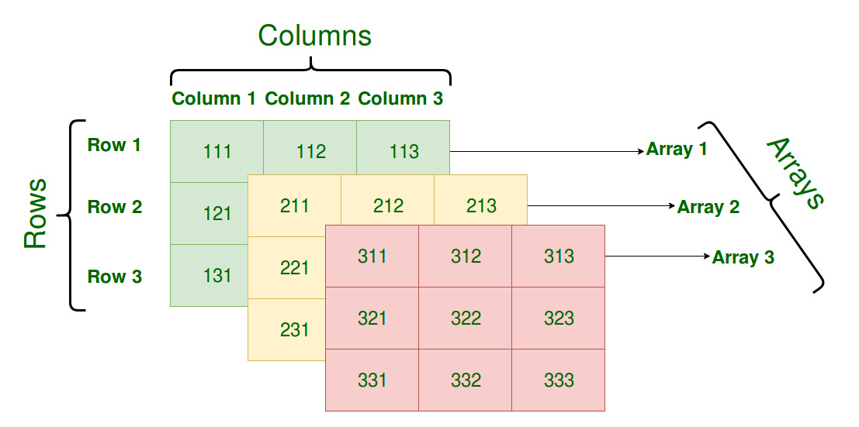
Types of arrays with examples?
3D Array:Used in more complex data structures.
int[][][] threeDArray = new int[2][2][2]; // A 2x2x2 3D array
threeDArray[0][1][1] = 5;
System.out.println(threeDArray[0][1][1]); // Outputs 5

Slide 8
Example of single dimensional array
class Testarray{
public static void main(String args[])
{
int a[]=new int[5]; //declaration and instantiation
a[0]=10;//initialization
a[1]=20;
a[2]=70;
a[3]=40;
a[4]=50;
for(int i=0;i<a.length;i++)
{
System.out.println(a[i]);
}
}

Slide 9
Example of multi dimensional array
public class MatrixMultiplication {
public static void main(String[] args) {
int[][] matrixA = {
{1, 2, 3},
{4, 5, 6}
};
int[][] matrixB = {
{7, 8},
{9, 10},
{11, 12}
};
int rowsA = matrixA.length;
int colsA = matrixA[0].length;
int colsB = matrixB[0].length;
int[][] resultMatrix = new int[rowsA][colsB];
// Perform matrix multiplication
for (int i = 0; i < rowsA; i++) {
for (int j = 0; j < colsB; j++) {
for (int k = 0; k < colsA; k++) {
resultMatrix[i][j] += matrixA[i][k] * matrixB[k][j];
}
}
}
// Display the result matrix
System.out.println("Result of Matrix Multiplication:");
for (int i = 0; i < rowsA; i++) {
for (int j = 0; j < colsB; j++) {
System.out.print(resultMatrix[i][j] + " ");
}
System.out.println();
}
}
}

